Slide 1

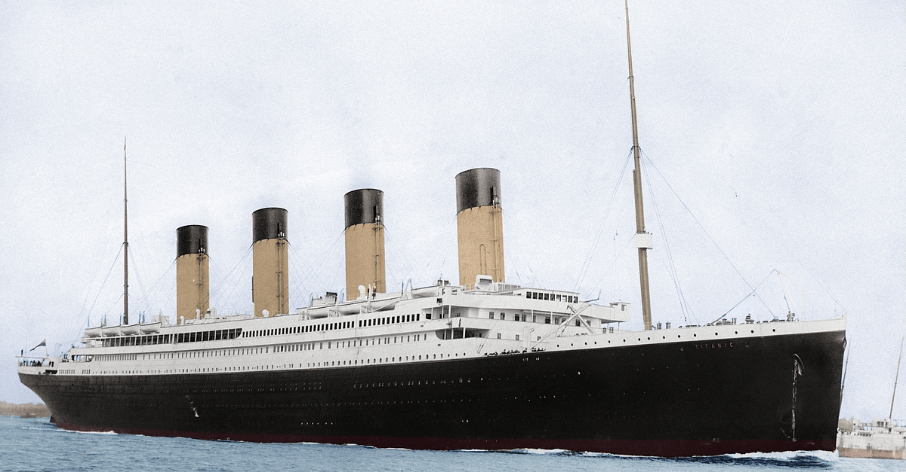
Survival Insights: Exploratory Data Analysis on Titanic Passengers
Exploring Passenger Survival and Building Predictive Models with Random Forest
Ezra Satria Bagas Airlangga

Slide 2
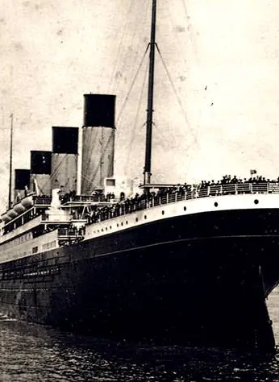
Background
The RMS Titanic was the largest passenger ship of its time, which sank on its maiden voyage in 1912.This tragedy has inspired numerous studies aimed at understanding the factors behind passenger survival.Using a data science approach, this project conducts an exploratory analysis of Titanic passenger data to identify patterns based on age and gender.In addition, a predictive model using Random Forest is applied to reinforce the analytical findings.

Slide 3

Project Goals
This analysis was conducted to thoroughly understand the Titanic passenger data and identify the factors that influenced the likelihood of survival.
In addition, this project includes the application of a machine learning model to predict survival based on passenger characteristics.
Understand the structure and characteristics of the Titanic dataset
Handle missing values, particularly in the age feature
Explore relationships between features such as age and gender with survival
Identify patterns relevant to passenger survival
Build a predictive model using Random Forest

Slide 4
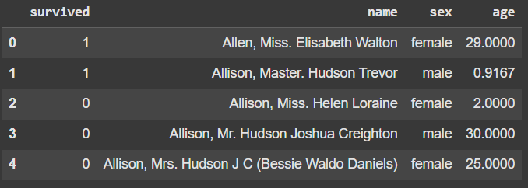
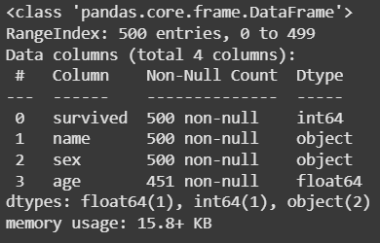
Data Overview
The dataset used is a subset of the publicly available Titanic passenger data, which is commonly used in data science learning.
It contains key information such as survival status, gender, age, and passenger names.
Dataset size: 500 rows (passengers)
Key features:
survived (0 = not survived, 1 = survived)
sex (gender)
age (age)
name (full passenger name)

Slide 5

Data Preprocessing

Slide 6
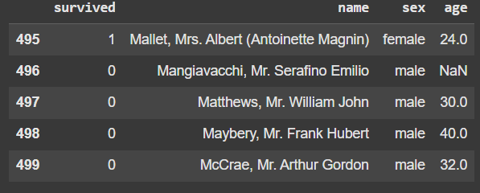
Showing Top & Bottom Rows of the dataset
To understand the data structure in general, the first step is to look at the top and bottom rows of the dataset. This helps to identify the data types, column formats, and potential inconsistencies.
The data.head() function displays the first 5 rows of the dataset: Provides an initial overview of the data contents and value types.
The data.tail() function displays the last 5 rows of the dataset: Useful for checking consistency and the final rows.
Features observed: name, sex, age, survived.

Slide 7
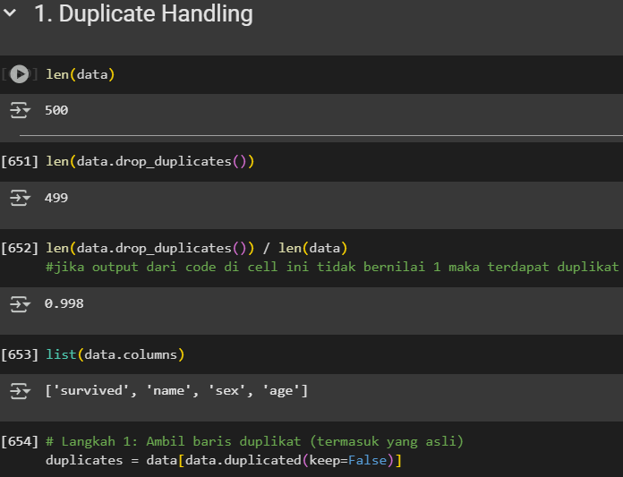
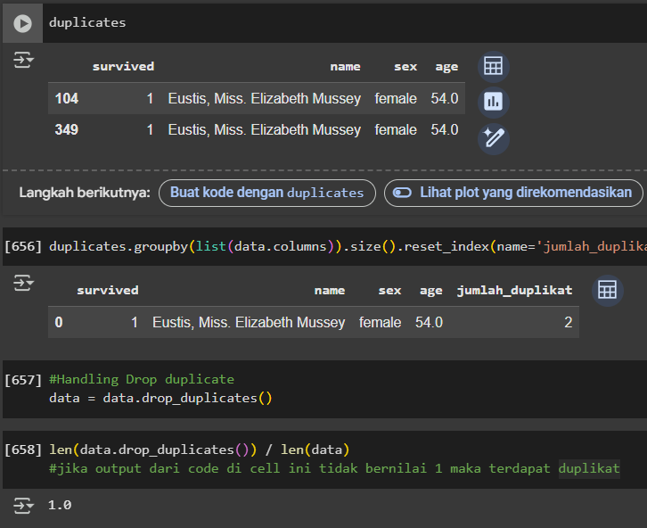
Duplicate Handling
Duplicate checks are performed to ensure that there are no repeating data entries that could affect the analysis.
Initial data total: 500 rows
1 duplicate entry found: 'Eustis, Miss. Elizabeth Mussey’
Duplicates were detected using: `data.duplicated(keep=False)`
Duplicates were removed with: `data.drop_duplicates()`
Final data: 499 rows (ratio = 1.0, no duplicates remaining).

Slide 8
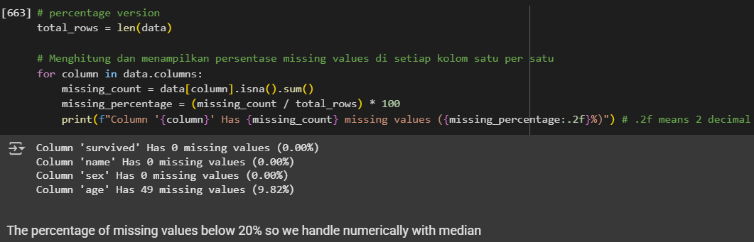
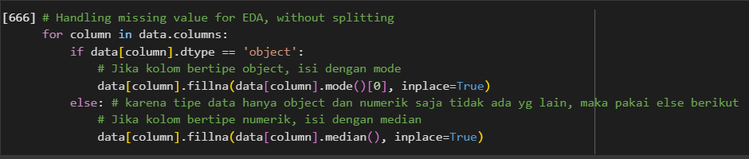
Missing Value Handling
To ensure data quality, missing value handling is performed using an appropriate approach based on the data type.
For columns with object (categorical) data type: filled using the mode (the most frequent value).
For columns with numeric data type: filled using the median.
The median is chosen because it is stable against outliers and suitable for data with missing values less than 20%.

Slide 9
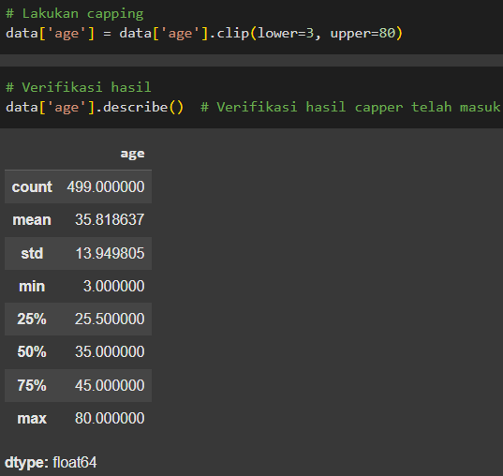
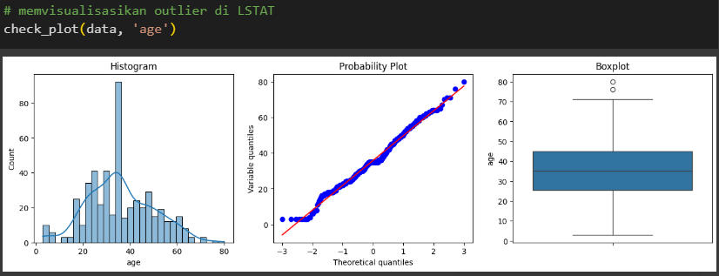
Outlier Handling
Outliers can disrupt the data distribution and affect the analysis results as well as model performance, so they must be handled carefully to avoid distorting important information in the data.
Column handled: age
Children under the age of 3 were not allowed to board the Titanic for safety and shared responsibility reasons.
Ages above 80 are considered outside the general passenger population of that time.
Values outside this range are clipped to the nearest boundary value.

Slide 10
Modeling and Evaluation

Slide 11
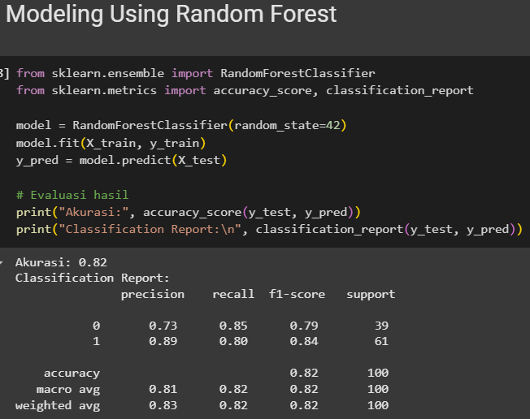
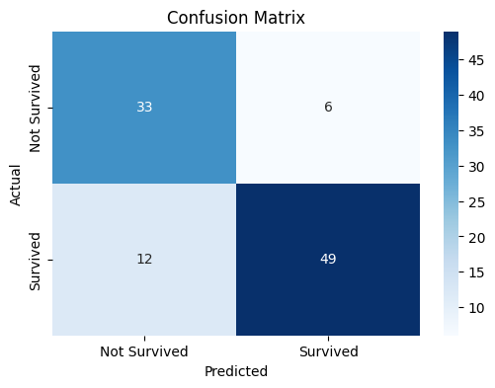
Modeling Using Random Forest
The Random Forest model is used to predict the survival of Titanic passengers. Evaluation is performed using test data with accuracy, precision, recall, f1-score, and confusion matrix as metrics.
The Random Forest model achieves an accuracy of 82%.
Performance for the "survived" class is excellent (precision: 0.89, f1-score: 0.84). The recall is high for the "not survived" class (0.85), indicating that the model is quite reliable in capturing these cases.
Confusion Matrix:
33 true negatives (correctly predicted not survived)
49 true positives (correctly predicted survived)
6 false positives (incorrectly predicted survived)
12 false negatives (incorrectly predicted not survived)

Slide 12
Exploratory Data Analyst

Slide 13
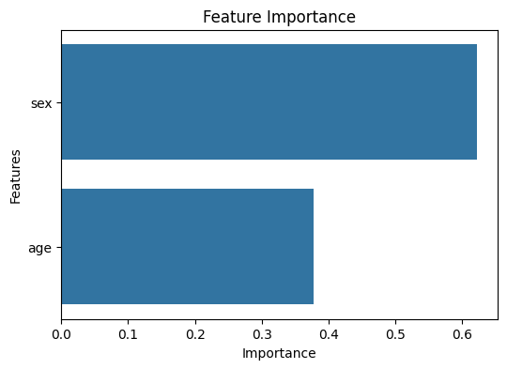
Feature Importance
The feature importance plot indicates that sex plays a significantly larger role in the model's prediction compared to age. This aligns with historical context, females were prioritized for rescue ("women and children first") and shows that the model has successfully learned this pattern from the data.

Slide 14
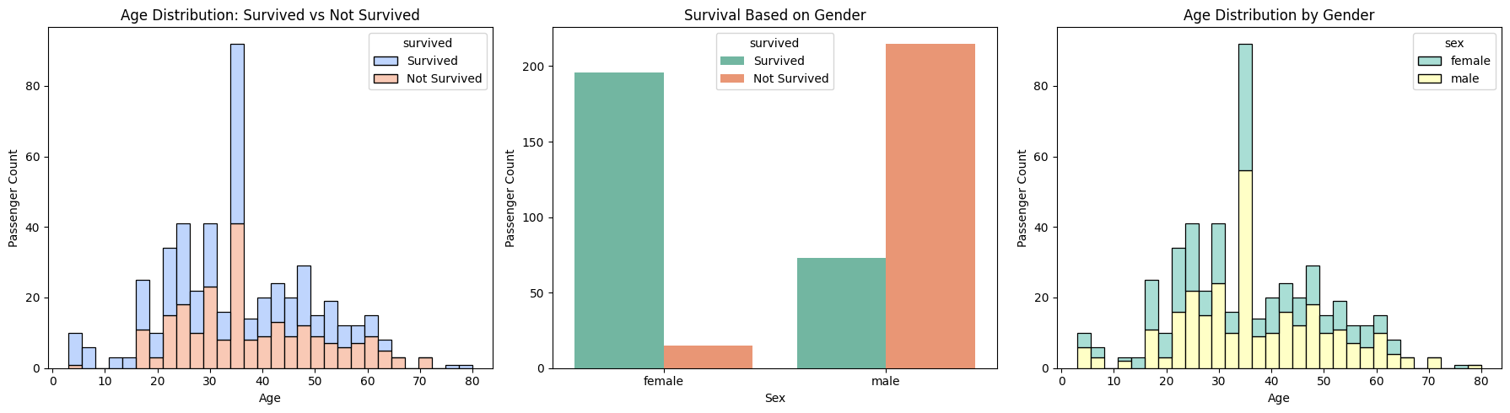
Data Visualization
The histogram of passenger age distribution, segmented by survival status, shows distinguishable patterns:
Survivors tend to be younger.
Older passengers are more represented in the group that did not survive.
This supports the idea that while age has some influence on survival probability, its effect is secondary compared to the gender feature.

Slide 15
Conclusion

Slide 16

Throughout the exploratory data analysis and modeling process, several insights were gained:
The dataset was successfully cleaned duplicates removed, missing values imputed, and outliers handled effectively.
The Random Forest model performed well in classifying survival status using only two features.
Among these, sex was the most influential feature in the model, followed by age.
Visualizations and feature importance analysis further validated these conclusions, showing that female and younger passengers had higher chances of survival because females were prioritized for rescue (women and children first)
Overall, the preprocessing steps significantly enhanced the model's performance and provided meaningful insights into the Titanic dataset.

Slide 17

THANK YOU
Ezra Satria Bagas Airlangga

